Slide 1


BYU Management Society Africa Business Plan Competition 2026
PRINCESS CHIDIEBUBE FASHION ENTERPRISES

Slide 2
Problem or Customer Pain Point
My community is far from the urban area so most people face serious difficulty accessing cash, Banks, ATMs are always crowded, and sometimes even run out of money. The people in my community spend hours travelling to the available Banks and ATMS Machines just to withdraw a small amount of money and sometimes are denied of access to their money even when they needed it the most because of ATM not dispensing the amount of cash they need or Banks has close.
Based on my personal observation and conversations:
About 85 out of 100 people in my area prefer POS services over banks.
Cash shortage and long queues are consistent pain points. This shows there is a strong local demand for fast, reliable cash access.
Long distance of bank from area that takes more than one hour thirty minutes to access bank and ATM machines
Cost of transportation to available ATM machines at the urban area.

Slide 3
Business Venture, Product or Services
Our business provides POS and digital banking services that make it easy for customers to:
Withdraw or deposit cash
Buy airtime and data
Pay bills (electricity, school fees, etc.)
Transfer money to local banks
We charge a small fee per transaction and earn commissions from banks
Our model is simple but powerful we bring financial access closer to people in the community to reduce stress and ATM disappointment
Cost Structure:
POS terminal setup
Cash liquidity
Rent maintenance
Agent salaries and Branding & marketing
Revenue Streams:
Transaction fees
Commissions
Digital service margins (airtime, bill payments)

Slide 4
Market Size and Growth
We serve Finima Bonny Island, Rivers State with an estimated population of 2,000 – 3,000 people
and with few active ATMs.
Over 75% of residents rely on POS agents for daily cash needs.
Competitor Analysis
Competitors | Strength | Weakness
Local POS Agents | Already known | Out of cash most times
Bank | Secure | Far distance and stressful
Bank | Secure | Closes early and ATM machines dispenses small amount

Slide 5
Market Size, Competition & Growth Potential cont…
Growth Plan
Expand from 1 POS location to more than 3 by next year.
Introduce digital wallet and agent sub-franchise system.
Build customer trust through consistent service and branding.
Introduce fashion hub near the POS kiosk
Risk & Mitigation
Risk | Mitigation
Cash shortage | Maintain backup liquidity & partner with agents
Network downtime | Use multiple bank terminals

Slide 6
Marketing and Sales Strategy
We attract and retain customers through trust, visibility, and reliability.
Customer Acquisition:
Word of mouth & community reputation
Flyers at markets and schools
WhatsApp, Facebook, and Instagram awareness
Promotion:
Loyalty reward (free airtime after 10 transactions)
Discounts during festive periods
Pricing:
Standard ₦100 fee per ₦5,000 withdrawal
₦50–₦100 for bill payments or transfers
Distribution Channels:
Kiosk/stand locations in busy areas
Partner agents in nearby communities

Slide 7
Financials Performance
Month (2025) | Cash Bought | Revenue/ Gain | Expenses | Net Profit
February | #1,000,000 | #500,000 | #100,000 | #400,000
March | #1,000,000 | #510,000 | #100,000 | #410,000
April | #1,000,000 | #400,000 | #50,000 | #350,000
May | #1,000,000 | #550.000 | #100,000 | #450,000
June | #1,000,000 | #600,000 | #100,000 | #500,000
July | #1,000,000 | #580,000 | #100,000 | #480,000
August | #1,000,000 | #600,000 | #100,000 | #500,000
September | #1,000,000 | #620,000 | #100,000 | #520,000

Slide 8
Financials Performance Cont…
Total Revenue (8 months):
₦4.36M
Total Profit (8 months):
₦3.610M
Avg Monthly Profit:
₦451,250

Slide 9
Financial Forecast (2026 Projection)
Item | Month | Annual | Remarks
Revenue | #700.000 | #8,500,000 | Growth from expansion + new POS units
Expenses | #150,000 | #1,850,000 | More agents & operations in different locations
Net Profit | #550.000 | #6,650,000 | +40% projected growth

Slide 10
Key Risk Factors & Mitigation
Risk | Impact | Mitigation Strategy
Cash shortages / liquidity issues | High | Maintain reserve fund; partner with multiple cash suppliers
Competition from other agents | Medium | Build brand trust, quick service, loyalty promos
Network / transaction delays | Medium | Use multi-bank POS systems + reliable internet
Security risks (fraud, theft) | Low | CCTV, staff training, and cash-handling limits

Slide 11
Management Team
We work together as field experienced, and adapt to understand customers better and how to scale gradually while maintaining good service.
Name | Role | Key skills
Kingsley Thomas | Partner and Operation Lead | Strategic planning, finance, customer relations
Princess Chidiebube | Founder and Business Manager | Day-to-day operations, POS management, client support

Slide 12
Use of Prize Money
ITEMS | AMOUNT | PURPOSE
2 new POS terminals | #250,000 | Extend to new areas
Branding and signage | #150,000 | Visibility and trust
Marketing | #50,000 | Customer acquisition
Backup liquidity | #300,000 | Keep steady cash flow
New staff training | #85,000 | To improve efficiency and deliver excellent service
Total | #835,000
The prize money will help us scale operations, create jobs, and serve more unbanked people in our community.

Slide 13
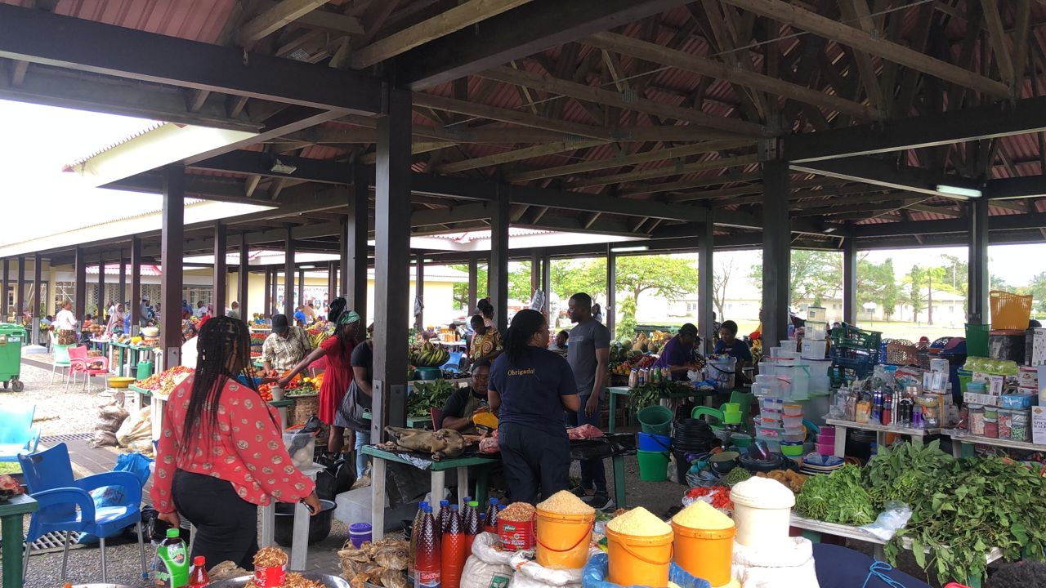
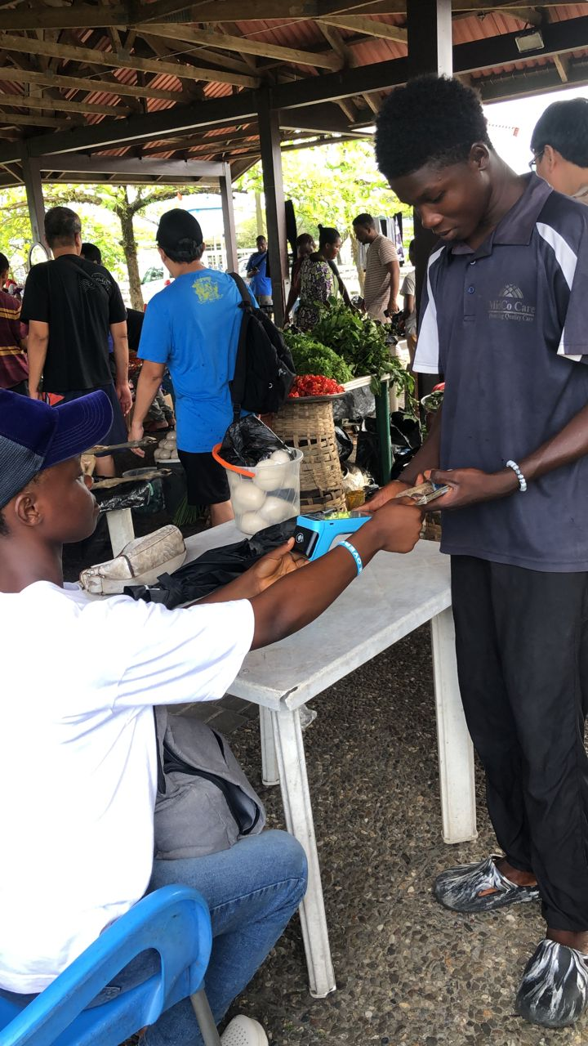
Photos of my business

Slide 14
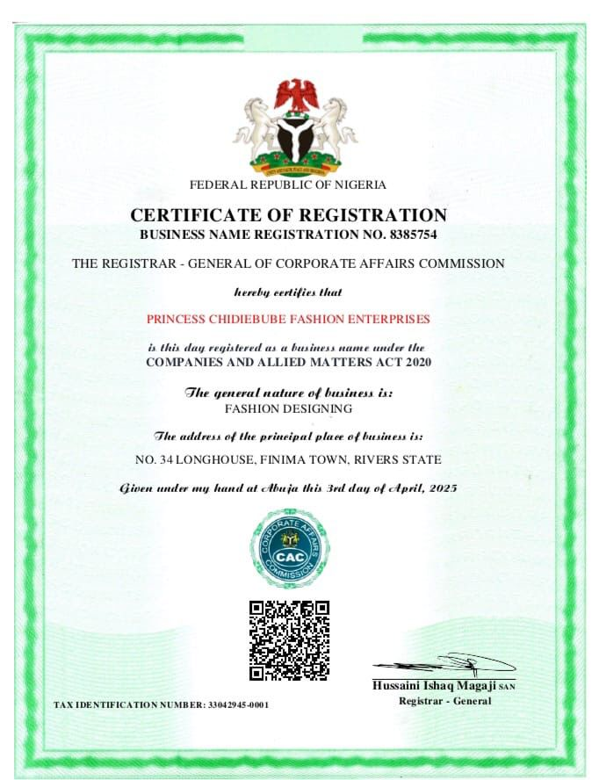
Business Registration or Licenses

Slide 15
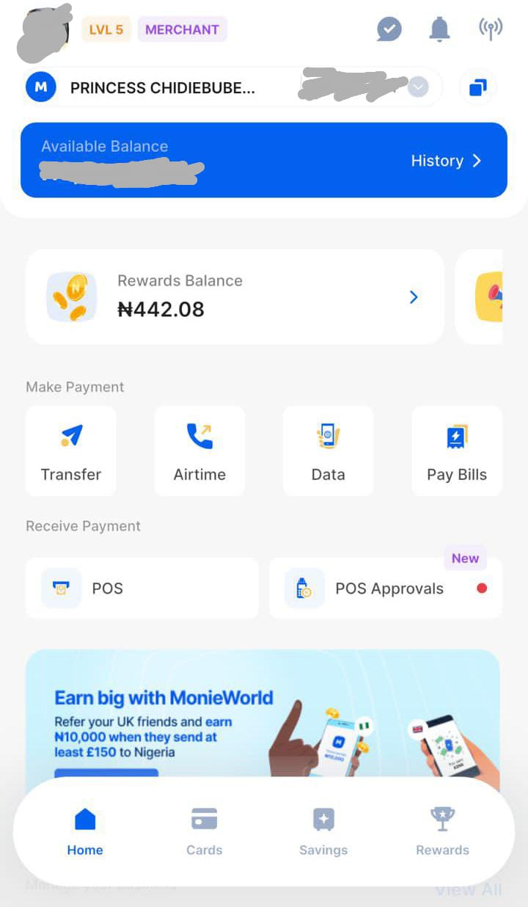
Business bank account

Slide 16
Thank You
PRINCESS CHIDIEBUBE FASHION ENTERPRISES
Serving a better Nigeria

